Slide 1


The Rotary Foundation
“TRF In Your Club”

Slide 2
Key Outcomes…
To help you understand and promote the Rotary Foundation in Your Club!
  Extending knowledge of The Rotary Foundation
  Exploring means of giving and recognition
  Sharing ‘how to’ increase participation in the TRF
  Celebrating the imprint of The Rotary Foundation!

Slide 3


WHY….The Rotary Foundation?

Slide 4
WHY….The Rotary Foundation?
Global Grants
District Grants
Polio Plus
Ambassadorial Scholarships – 2 to 3 from this district each year
Peace Scholarships – awarded this year
Notes:
2026/27 Global Grants (37 grants in various stages) – District 5020 helps clubs increase the value of their fundraising through matching funds.District 5020 matches 200% of cash donations from clubs in our District, up to $35,000 in District Designated Funds (DDF) per grant. The Rotary Foundation’s World Fund then matches 80% of all District funding.
For example:
Funding Source Amount Club contributions US$18,000,District 5020 match (200%),US$35,000
Rotary Foundation World Fund (80% of District funding) US$28,000Total project funding
US$81,000
For the minimum Global Grant of US$30,000, clubs generally need about US$6,500 in contributions from District 5020 clubs.
Partnership opportunities -
Clubs can partner with other Rotary clubs to develop larger projects.
District 5020 also supports grants initiated in other districts by matching club donations 100% up to US$15,000, subject to a completed DDF application.
Grant limits
A club may have up to six active Global Grants at one time.
New grants are approved only if existing grants are in good standing.
Club consideration a Global Grant should contact the District Global Grant Chair before starting the process.
District Grants (approx. 55 each year) – every club in the District can apply for a minimum of a $2,000 matching grant. These are for local and international projects Your club can also go together with another club to apply for a matching District Grant.
Up to $100US per capita is eligible for a $2,000US district grant
$100US to $199US per capita is eligible for a $3,500US district grant
$200US per capital or more is eligible for a $5,000US district grant.
Scholarships – These students could receive as much as $45,000 for post graduate studies in another country.
Peace Scholarships - a masters or certificate program to study peace and conflict resolution at on of the 8 peace centres in the world.

Slide 5
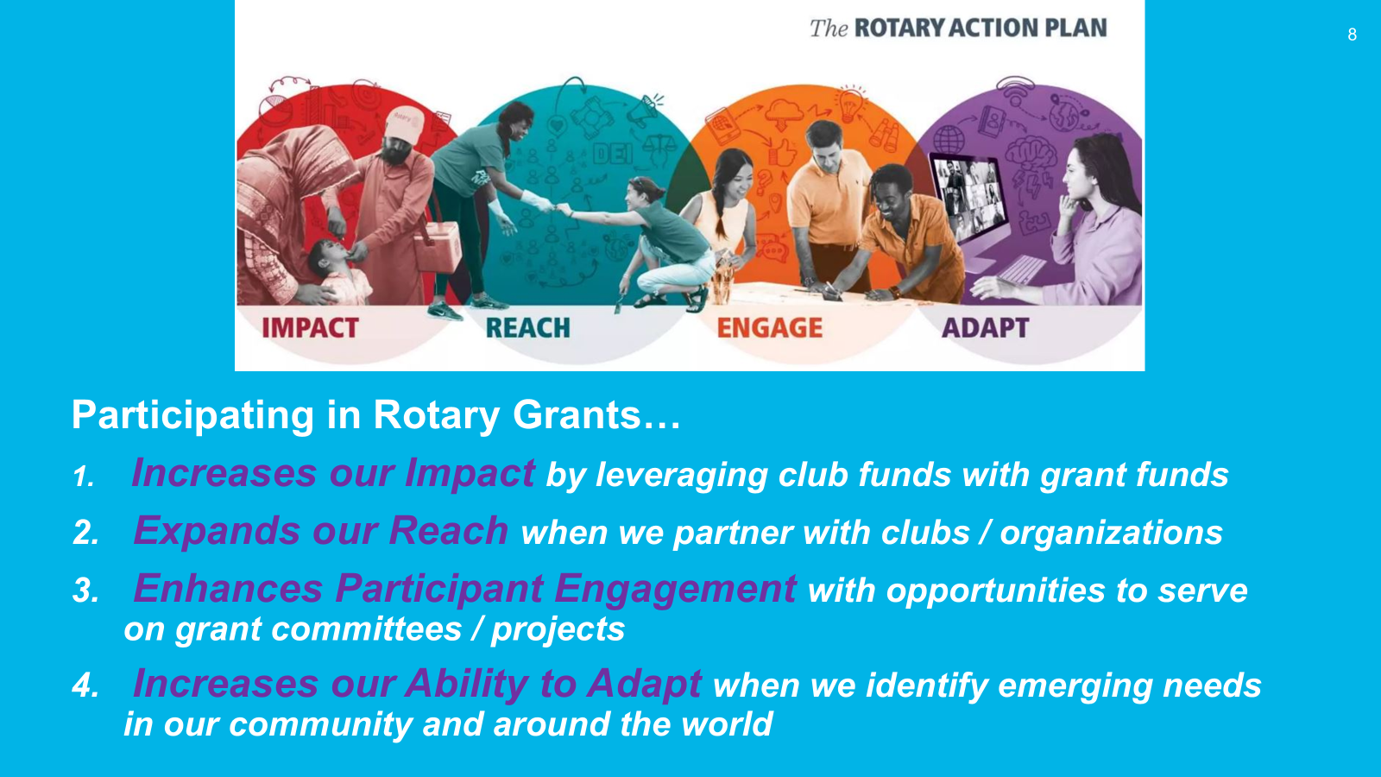
Notes:
Rotary Action Plan.
Demonstrates the clear tie in that grants have to carry our the Rotary Action Plan. This slide demonstrates those connections.

Slide 6
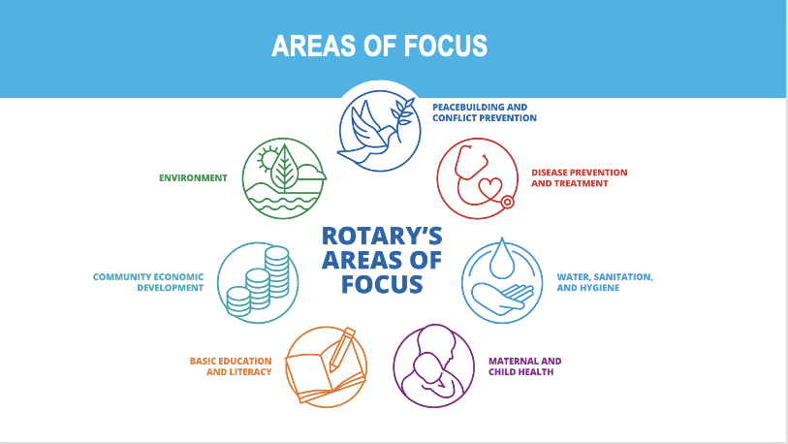
Notes:
This slide reminds us of the 7 areas of focus. These areas address so many needs in our larger world community.
Rotary grants must serve one of these areas.

Slide 7
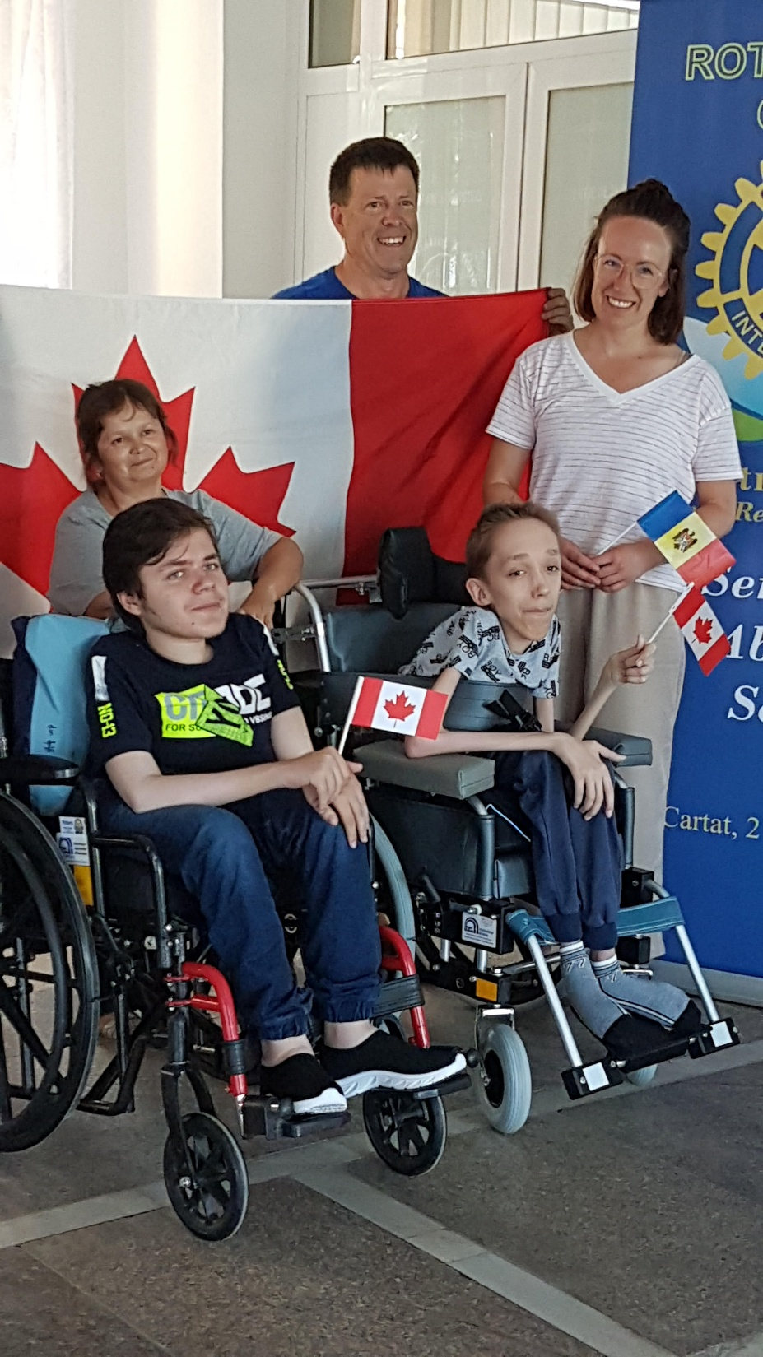
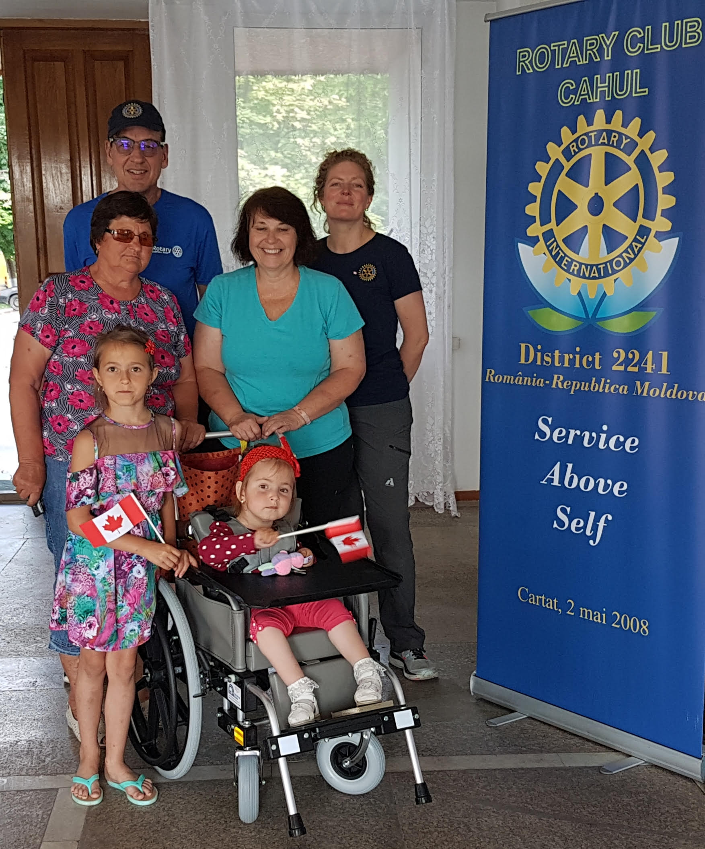
Romania and
Moldova
W Romania and
Moldova
Wheelchair
Delivery heelchair
Delivery
Notes:
You may want to include photos of your club’s district or global grant projects.
We often talk about beginning with the end in mind. This is what The Rotary Foundation can do to "Create Hope in the World". Look at this photo.
As a club you have many photos that could be inserted here to reflect the difference your club has made. This one is just an example.
These images are your dollars at work! This is the ‘WHY’ we support the Rotary Foundation.

Slide 8
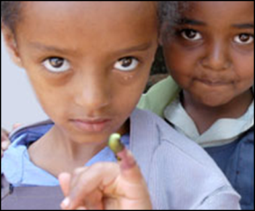
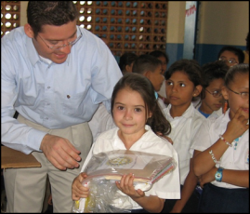
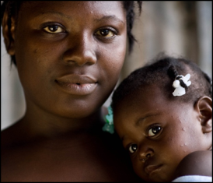
Knowledge of THE ROTARY FOUNDATION
POLIO PLUS FUND
End Polio Now
ANNUAL FUND
For Support Today
ENDOWMENT FUND
To Secure Tomorrow
Can you name 3 buckets in which we give to
The Rotary Foundation?

Slide 9
Knowledge of THE ROTARY FOUNDATION
POLIO PLUS FUND
End Polio Now!
ENDOWMENT FUND
To Secure Tomorrow
ANNUAL FUND
For Support Today
Notes:
We often think of our Foundation contributions in three ways.
In looking at this slide, what are some of the ways in which our Rotary giving is focused?
The PolioPlus Fund, dedicated to global polio eradication money is spent in the year it was earned and these funds receive a 2:1 match from the Gates Foundation.
The Annual Fund, primary source of funding for Foundation grants and activities (scholarships) – 47.5% of funds donated come back to the district (DDF) three years later.
The Endowment Fund supports the Foundation in perpetuity (only the interest is spent each year)

Slide 10


TRF: Three Buckets
PolioPlus
Annual Fund
Endowment
Fund
Annual Fund
Wills…
Bequests
Notes:
One of the most powerful images to use when talking about The Rotary Foundation is to use the three buckets analogy.
PolioPlus:
eg. All dollars collected for polio plus are spent in that year. We are 'this close' to worldwide polio eradication. The 2 drops help immunize children throughout the world. It is Rotary's goal to eradicate polio.
Annual Fund:
eg. This is a significant bucket because the funds gathered are invested for three years and then 47.5% are returned to the district to assist with both community and global grants.
Wills/Bequests - Endowment Fund:
eg. Sometimes referred to as the permanent fund....these dollars are in large part expectancies...often designated in people's estates. These dollars are never spent...however, the interest accrued is added to the annual funds that support Rotary grants. Give to the Endowment Fund is to become a Benefactor or join Bequest Society (these are referred to later in presentation)

Slide 11

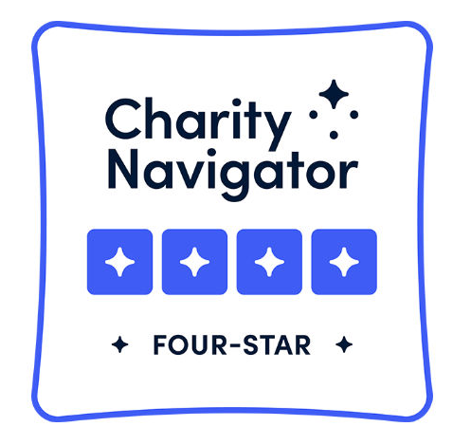
The Gates Foundation… match Rotarian donations 2:1 to End Polio
90% of funds go to Rotary projects and programs
www.charitynavigator.org
17 years
highest rating!!
Notes:
Who has heard of Charity Navigator?

Slide 12
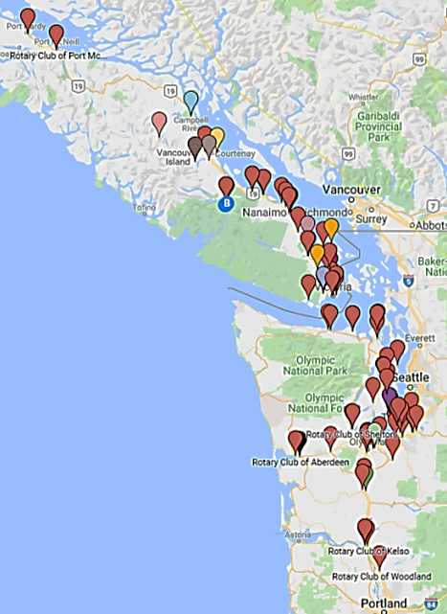
ppppp
D 5020 Membership:
Then (2019) and Now (2026) as of July 1
4507 3596
3,978 Rotarians
92 Rotary Clubs (18 Areas)
Area 60: OAK BAY (59 / 52)
Saanich (24 / 19), Sooke (30 / 26),
Victoria (57 / 21), West Shore (33 / 26)
144 ROTARIANS
Notes:
Even though we have less Rotary members in the district we continue to have the same number of grant requests. For this reason, it is even more important that every Rotarian tries to support the Rotary Foundation so we can continue the ‘good work of Rotary’

Slide 13
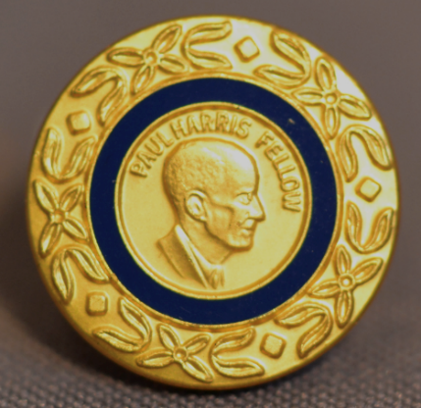

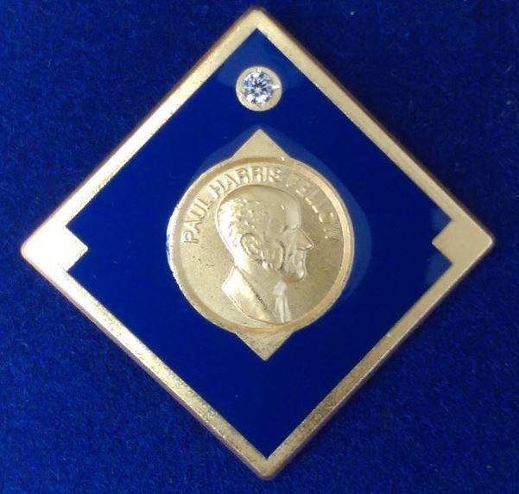
CELEBRATE …… Donor recognition !
INDIVIDUAL DONOR RECOGNITION
      Paul Harris Fellow
      Paul Harris Society Member
      Major Donor
      Benefactor - $1,000
      Bequest Society - $10,000
Notes:
Who can explain one of these 'types' of donor recognition?
Donating to The Rotary Foundation should be a cause for celebration.
Many clubs make recognition a very special part of a meeting or a special celebration meeting on its own.
How does your club celebrate donors to The Rotary Foundation?

Slide 14

WAYS TO GIVE
  *Log in to rotary.org/donate (My Rotary)
  *Sign up for ROTARY DIRECT
  *Mail your gift directly or phone (866 976 8279)
  *Give donation to Club Foundation Chair to submit
  *Distribute a pledge form to club members
  *Welcome non-Rotarian donations!
ROTARY DIRECT
Rotary HELP DESK
866 976 8279
Notes:
And now to a very important part of today’s presentation. Without dollars to fund projects we are so limited in the impact we can have on lives.
Remember The Rotary Foundation has received 4 stars (highest rating) on charity navigator for the last 16 years.

Slide 15

TIPS …. For a strong Club Foundation
How can you make
The Rotary Foundation a vibrant part of our club?
TRF
Notes:
Strong and consistent commitment to Rotary Foundation giving doesn't happen by chance.
Vibrant Rotary clubs have several approaches in mind to keep The Rotary Foundation program a journey. As a club we can play a significant role in the success of The Rotary Foundation.
What are some of the suggestions you would offer....or successes your club has experienced?

Slide 16

Every Rotarian Every Year …… Banner
Every club Rotarian gives a minimum of $25 USD ($35 CAD) to the Annual Fund
Club members give an average of $100 USD
to the Annual Fund
Notes:
I’d like to extend the idea of Every Rotarian Every year. The concept as we have heard is quite simple.
It means every club member has given at least 35 CAD to The Rotary Foundation….and the average giving for the club exceeds 100 U.S.
At first look given that we are all very generous and heart connected members of our club and community, it would seem very easy. As you heard last year there were only 3 clubs on Vancouver Island.

Slide 17
Notes:
Rotary has many inspirational materials and resources that are reminders to all of us….reminders of our privilege and the opportunities we have because of our first world advantages.
Individually our imprint might be negligible….but together…the imprint on lives could be astonishing. Our time is finite…but the resources we contribute can pay forward so many opportunities for years to come.
If you are interested in learning more about the Rotary Foundation there is a lot of information on the RI website also go to the Rotary Learning Centre as there are a number of courses offered about the Rotary Foundation such as Foundation basics, Club Foundation Committee, Grant management courses etc.

